Slide 1
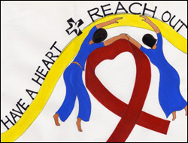
2011
Logo from Malaysia, courtesy of Church World Service
Copyright: Center for the Church and Global AIDS

Slide 2
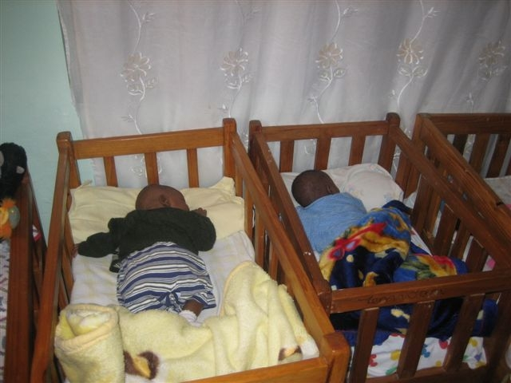
Staggering HIV & AIDS Statistics
34 million people infected world-wide; almost 50% women
In the USA, 1.2 million infected; 25% do not know they are infected
Over 15 million orphans
No cure or vaccine
Peter & Paul in
AIDS orphanage in Zambia

Slide 3

On Valentine’s Day
All of us on like to be reminded we are loved . . .
But do we really need yet another box of candy or bouquet of flowers?
Or can we give an alternative gift of “love and life to an AIDS orphan”, as suggested by Bishop Elaine J. W. Stanovsky?

Slide 4
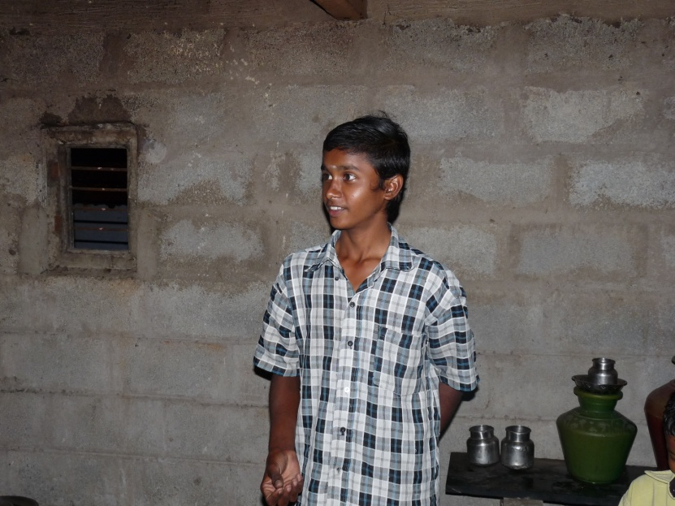
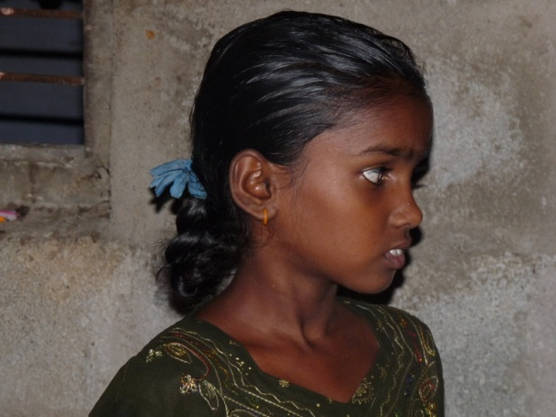
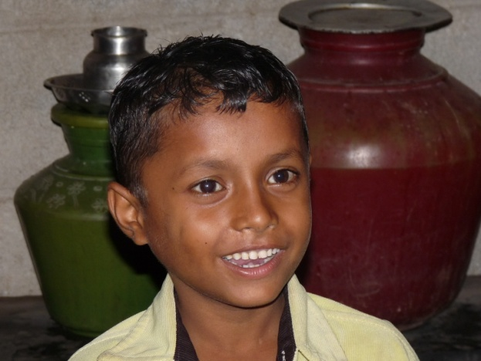
Money Given Goes To India
Your Valentine’s gift helps people like this child-headed household where both parents have died of AIDS. They live together alone.
Siva—works 10 hours daily six days a week, cleaning eggs, to earn a living.
He cares for his sister—Gomathi, now 13, who cooks and goes to school despite TB,
And a 9 year-old brother Murugan who is infected with HIV
Siva
Gomathi
Muruguan

Slide 5

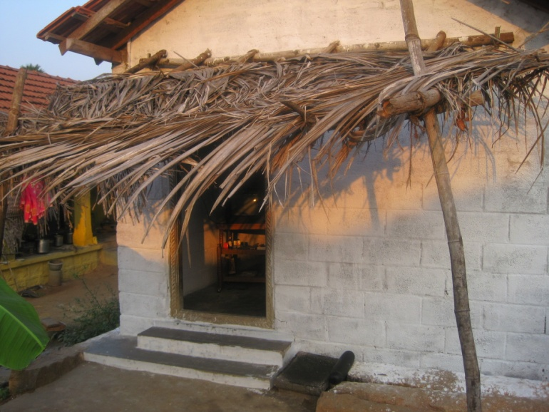
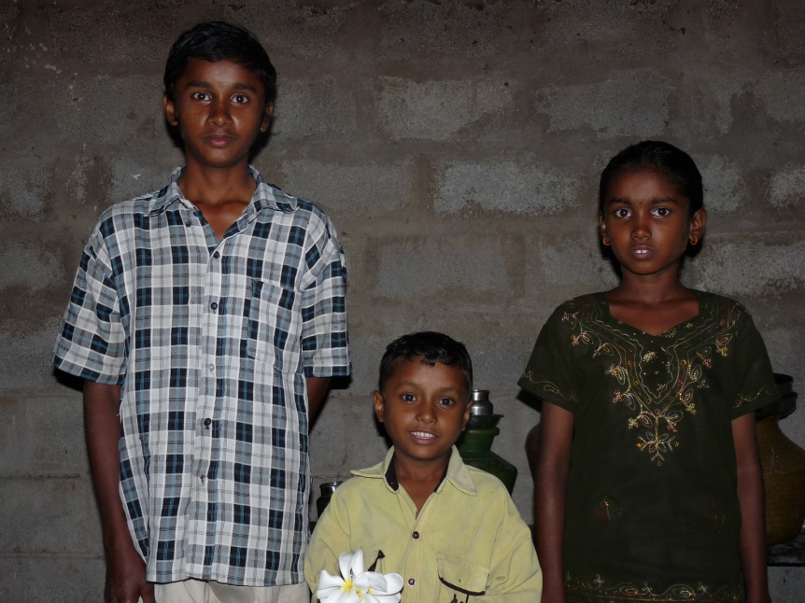
United Methodist Global AIDS Fund
Partners with agencies like the Women & Children’s Center in rural India
The Fund has made 175 grants in 37 countries in recent years
This Valentine’s Day “have a heart” and join to help “the least of these”
Home above built by five women volunteers from LaVeda Colorado United Methodist Church

Slide 6


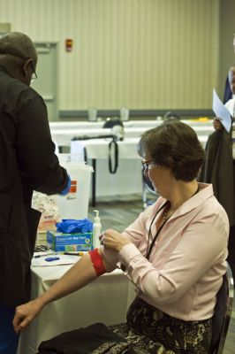
Thank You For Your Gift
UMCOR Advance
# 982345
If your heart is as my heart, let us join hands in this cause.”
Bishop Elaine J. W. Stanovsky
(Pictured to the right being publicly tested for HIV with other United Methodist bishops.)

